Slide 1


Резервное копирование, как обеспечение доступности данных.
Сокращение простоев и эффективное восстановление данных

Slide 2

Виталий Савченко
Руководитель группы технических консультантов Veeam Software
vitaly.savchenko@veeam.com

Slide 3

Аварийное восстановление и резервное копирование – это не про технологии, от слова “СОВСЕМ” ☺

Slide 4
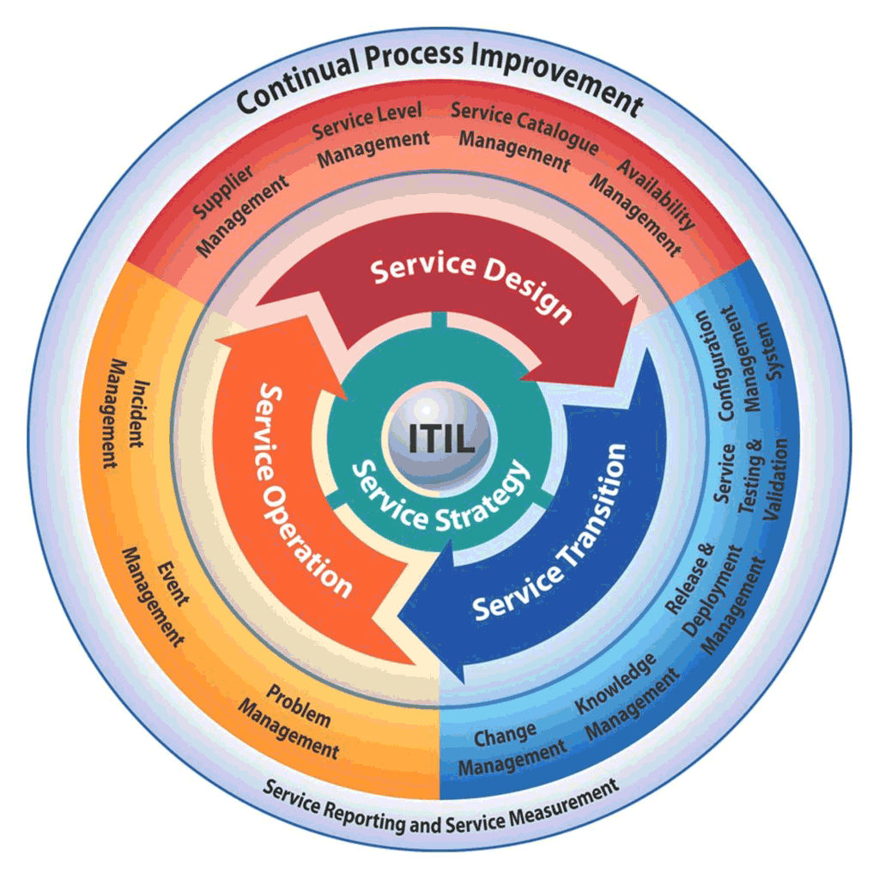
ЭТО ПРОЦЕСС который учитывает потребности бизнеса

Slide 5
О чем мы думаем, когда говорим об аварии?

Slide 6


Slide 7


Масштаб бедствия
X
Это может быть весь ЦОД (не самый частый случай)
ЦОД
Notes:
Since most are small, or a part of, it means we design failover plans so one app can be failed over. Or all of them but we have granular choice.

Slide 8
Масштаб бедствия
X
Это может быть проблема с одним приложением, или набором приложений в рамках одного ЦОДа.
Приложение
Notes:
Since most are small, or a part of, it means we design failover plans so one app can be failed over. Or all of them but we have granular choice.

Slide 9

Аварийной восстановление (DR) – раздел планирования непрерывности бизнеса, связанная с технологическим восстановлением (а не с восстановлением бизнес операций).

Slide 10
Что нам нужно?

Slide 11
План аварийного восстановления (DRP) – набор политик, инструментов и процедур, для восстановления.

Slide 12

Основные стратегии хорошего DRP
Превентивные меры
Notes:
Since most are small, or a part of, it means we design failover plans so one app can be failed over. Or all of them but we have granular choice.

Slide 13
Превентивные меры
Отказоустойчивость всех компонентов
Кластеризация
Безопасность и антивирусная защита
Репликация
Резервное копирование
И так далее…..

Slide 14
Основные стратегии хорошего DRP
Обнаруживающие меры
Notes:
Since most are small, or a part of, it means we design failover plans so one app can be failed over. Or all of them but we have granular choice.

Slide 15
Обнаруживающие меры
Своевременные обновления всех компонентов
Обучение сотрудников
Системы мониторинга
Постоянное тестирование
И так далее…..

Slide 16
Основные стратегии хорошего DRP
Корректирующие меры
Notes:
Since most are small, or a part of, it means we design failover plans so one app can be failed over. Or all of them but we have granular choice.

Slide 17
Корректирующие меры
Runbook (последовательность шагов, что делаем, владельцы app, и так далее)
Инструменты для восстановления данных

Slide 18
Хороший DRP план должен отвечать хотя бы на 3 базовых вопроса.
Что является объектом плана и какие цели?
Кто будет ответсвенным, в случае аварии?
Что ответсвенные будут делать в случаее аварии (последовательность шагов)?
Notes:
Since most are small, or a part of, it means we design failover plans so one app can be failed over. Or all of them but we have granular choice.

Slide 19
Немного Veeam

Slide 20
5 этапов “Умного управления данными”
Этап 5
Этап 4
Automation
Этап 3
Orchestration
Этап 2
Visibility
Этап 1
Aggregation
Backup
Policy Based
Behavior Based
Notes:
Veeam can uniquely help customers along the 5 stages of their journey to Intelligent Data Management with innovative, reliable, easy-to-use solutions that “just work” in any
environment. Customers are never locked-in with Veeam because our solutions are agnostic to hardware, networking, storage, application, and cloud providers.
Stage 1: Backup
Back up all workloads and ensure they are always recoverable in the event of outages, attack, loss, or theft.
Stage 2: Aggregation
Ensure protection and availability of data across multi-cloud environments to drive digital services and ensure the aggregated view of service level compliance.
Stage 3: Visibility
Improve management of data across multi-cloud environments with clear, unified visibility and control into usage, performance issues, and operations.
Stage 4: Orchestration
Seamlessly move data to the best location across multi-cloud environments to ensure business continuity, compliance, security, and optimal use of resources for business
operations.
Stage 5: Automation
Data becomes self-managing by learning to back itself up, migrate to ideal locations based on business needs, secure itself during anomalous activity, and recover instantaneously.

Slide 21
Этап 1: Резервное копирование
Цель – резервное копирование ВСЕГО, для уменьшения потерь
82%
66%
Признают разрыв между ожиданиями от IT и что IT может предостваить
Признают, что это связано с внеплановыми простоями
Notes:
It is the job of CIOs to deliver the confidence to the business that all enterprise data is secure and instantly recoverable. And the confidence to users of the company’s services that their digital lives will proceed without interruption, without scattered availability problems, and without poor excuses as to why their information wasn’t available when, where, and how they need it.
Stage 1 on the journey to Hyper-Availability is first because it’s critical to ensure the security of data from a systemic perspective: i.e., to secure, back up, and recover all the various sets and kinds of data wherever they are so they are protected at all times against outages, attack, loss, or theft, and recoverable whenever there’s an issue. This stage is about ensuring that you can get your data back if it’s lost or compromised—and that the business survives.
In this stage, data growth is often managed by adding more storage devices or taking advantage of storage optimization techniques like data deduplication. As a result, data is often stored in individual silos, and there are minimal data insights and strong susceptibility to data sprawl. In addition, recovery times tend to be longer in this phase than what can be
achieved in later stages.

Slide 22
ЭТО ПРОЦЕСС который учитывает потребности бизнеса

Slide 23
Постоянная доступность
RTO (Recovery Time Objective)
Допустимое время, требуемое на восстановление информации
RPO (Recovery Point Objective)
Допустимая потеря информации
RPO
RTO
t
Backup
Failure
Restore

Slide 24





Этап 2: Агрегация
Цель - защита и доступность данных в multi-cloud.
В эпоху цифровой трасформации доступность нужна и для ВСЕХ типов нагрузки в “Облаке”.
Public Cloud
Private/Managed
SaaS
Notes:
Backup and recovery are essential for data security, but merely the baseline beginning of Hyper-Availability. Enterprises embracing digital transformation are striving to use the power and elasticity of the cloud to deliver rich digital experiences seamlessly to their users. In this new world, CIOs need data management solutions that enable them not only to survive as a business, but also to drive the digital transformation of the business.
Today, 85% of enterprises have a multi-cloud strategy. In multi-cloud environments, it becomes more challenging to ensure that data and applications are always available, to all users and all devices, across all cloud types including private, public, and hybrid environments. In this complex, distributed, dynamic environment, new challenges are rising: End-users are becoming ever more demanding, ransomware and other security threats are impacting businesses in profound ways, and business owners are fighting an uphill battle to innovate constantly and deliver seamless digital services to improve competitiveness.
This stage also enables use cases in multi-cloud environments that are driven by service providers. These include disaster recovery as a service (DRaaS), data protection for cloudbased
infrastructure and apps, data protection across multiple clouds, and more. The goal is to provide instant access to any data, any app, anywhere to drive recovery, analytics, application development, and uninterrupted digital services.
Stage 2 is about the aggregation of data protection for physical, virtual, and cloud services. To become a true digital enterprise, you need to connect all these backup and data protection systems scattered across multiple clouds into one easily manageable system. With Stage 2 mastered, backup and recovery are improved in that you can get your data back more quickly, seamlessly, and comprehensively, and there is a measurable return on investment through consolidation of resources and fewer subject matter experts required. With backups no longer siloed, you now have central management across a multi-cloud environment, and you can start to gain insights into how data growth can be managed. The ability to extract full value from your data, whether in the form of business or operational insights, is still very limited at this point, however.

Slide 25



Этап 3: Прозрачность
Цель - улучшение управляемости в multi-cloud среде. Прозрачность и контроль, выявление проблем с производительностью.
Основные задачи:
Прозрачность & управление для поставщиков услуг
Прозрачность app-to-metal
Единый контроль IT окружения
Notes:
Many enterprises have evolved a fragmented system of data visibility to go along with their reactive approach to data outages. Such a lack of unified, cross-domain visibility, however,
leaves IT reactive rather than proactive, with performance issues too often unresolved and continuing to impact the business. But, as an executive responsible for digital services, you need meaningful monitoring and telemetry applied wherever data may be. You need to know whether backup succeeded or failed, how much data was backed up, how much retained, and everything else the business might need to know about and from its data.
Ideally, a “single pane of glass” gives administrators one convenient place to perform all important tasks, including optimizing performance and storage resources based on policies. Backing up data from on-premises to the cloud, or vice versa—or moving data from cloud to cloud. Moving mission-critical data to higher performance storage systems, and lower priority data to less costly cloud storage. All this resulting from gaining complete visibility into performance needs and resource usage so you can optimize the system while easily
meeting any compliance and auditing requirements.
In addition, enterprises also face issues when introducing new applications or deploying updates to existing applications—or testing for compliance or security vulnerabilities. An unstable upgrade can cause a ripple effect throughout the organization, slowing productivity to a crawl; and security and compliance issues bring with them obvious problems. To mitigate this, enterprises need a way to leverage copies of their production environments for use in these scenarios, so that any issues can be addressed without disrupting production environments. This ability to create production-like environments arms IT departments with the visibility to become proactive sources of value-added services, rather than costly and reactive fire-fighting units.
In Stage 3, then, data management is evolving from a reactive measure, focused on remediating issues that have already occurred, to a proactive dynamic, preventing any loss in data availability through advanced monitoring, resource optimization, capacity planning, and built-in intelligence. This full operational insight into data is accompanied in Stage 3 by the ability to glean business insights from data to drive better business decisions. But the process is still manual, laborious and inefficient. With Stage 4, we begin to see an easier, more efficient way.

Slide 26
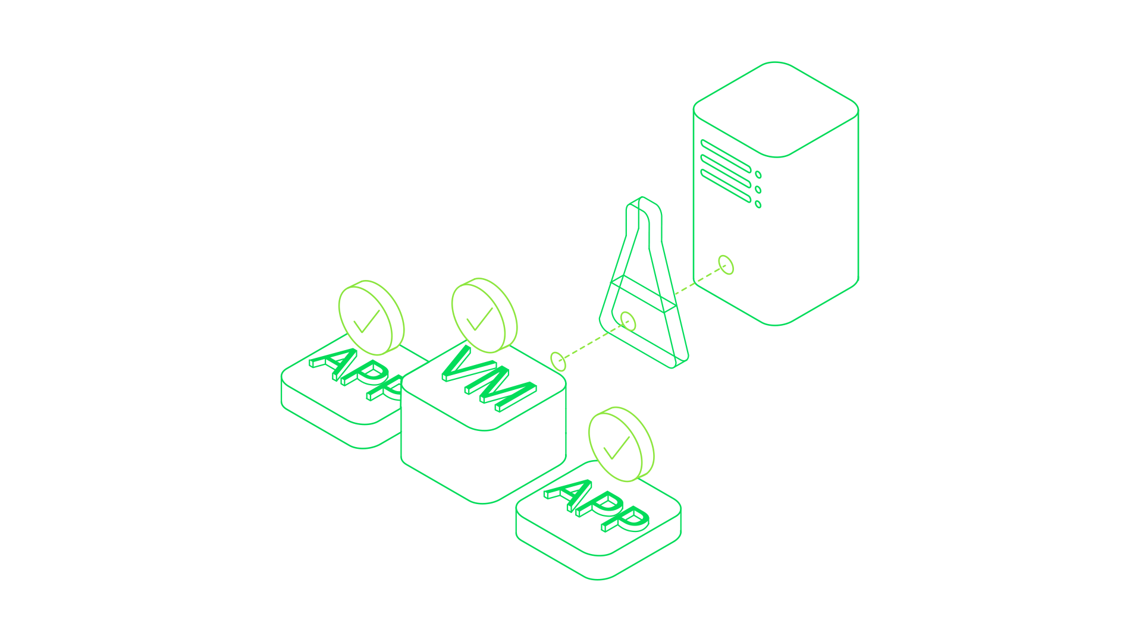
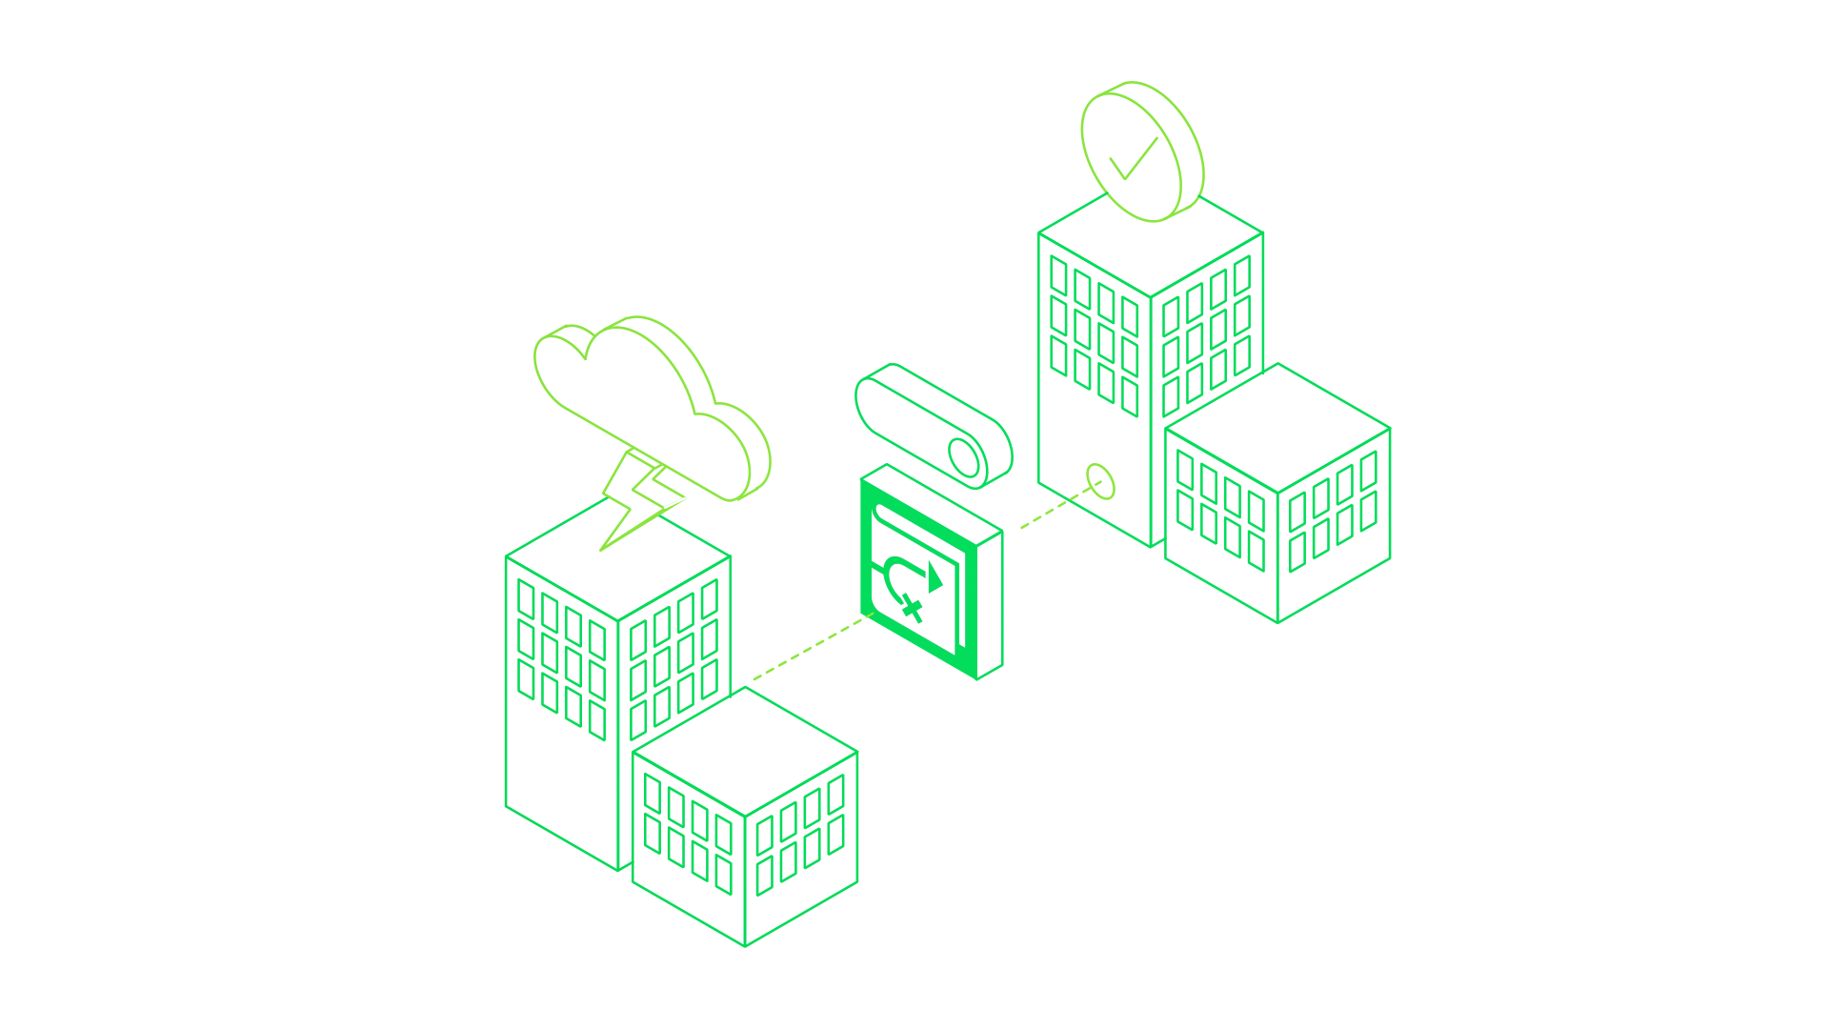
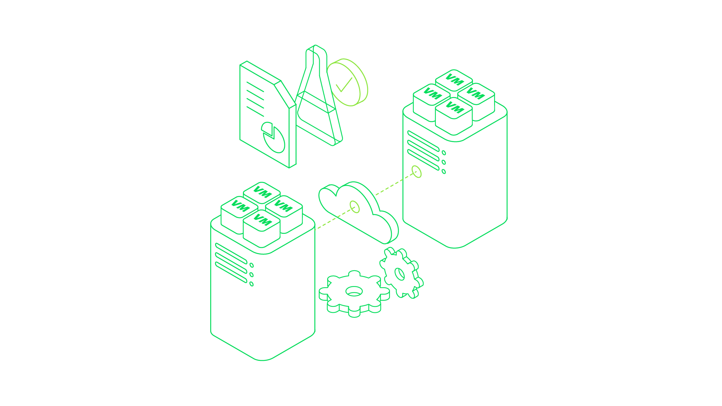
Этап 4: Orchestration (управление)
Цель - прозрачное перемещение данных между разными средами, для лучшей безопасности, оптимального использования ресурсов и т.д.
Простота тестирования, документирования плана аварийного восстановления
Непрерывное улучшение и тестирование
Высокая автоматизация всех процессов
Notes:
Stage 4 on the journey to Intelligent Data Management is to ensure that enterprise data is always on the right infrastructure, always protected, always ready to do work. That it’s always in the right place at the right time in the right way to drive the function required, whether it’s email data for a user, analytics for the business, or demonstration of compliance for an audit. To make this happen across multiple clouds and multiple sources of data requires orchestration capabilities beyond what have been available to date. What we’ve had instead are machine parts scattered about, awaiting an engineer who knows how to put them together.
These orchestration capabilities require workloads to move more easily from one infrastructure to another, and this workload mobility in turn requires a decoupling of the workload from its infrastructure—workload virtualization, in a sense. Once the workload is free, data can move from one location to another to adhere to regulations like GDPR, or for security or performance reasons. A workload running on a private cloud in Houston could be relocated to a managed cloud hosted by a service provider in Phoenix in the event of an approaching hurricane, for example, while years-old data that is rarely accessed and only retained for regulatory purposes can be moved to a low-cost public cloud environment. All of this can be done automatically, driven by policies.
The policies used to automate workload mobility need to be point-and-click easy for the administrator to set up and apply. Policies must leverage the new levels of visibility acquired in Stage 3 as well as strategic integrations with application vendors and cloud providers and other system providers in the data ecosystem.
In short, Stage 4 ensures business continuity and resource optimization via the orchestration of mobile workloads through automation informed by policies. Moving to
Stage 5 builds on this by introducing intelligent automation driven by data analysis, pattern recognition, and machine learning to yield a fully self-managing system.

Slide 27
Спасибо!

